Slide 1
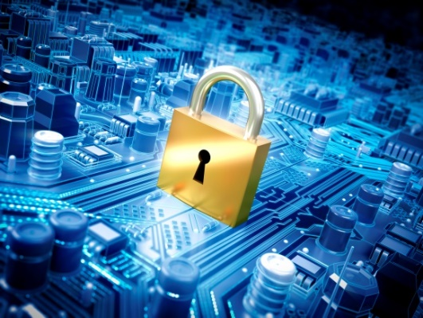
IT-648: IT Risk Management
Week 4
Sonja Streuber

Slide 2
Agenda
# | Topic | Reading | Due Sunday 11:59 pm CST on Blackboard
4 | The basic information security model: Common vulnerabilities, threats and controls | Agrawal 4 Other materials on Blackboard | W: Post F: Responses S: LAB_4

Slide 3
Chapter 4
System Administration (2)

Slide 4
Overview
By the end of this week, you will be able to:
Identify he elements of the basic information security model
Describe the relationships between the elements of the basic information security model
Explain and apply the common classification of information security controls

Slide 5
Basic Information Security Model
Any vulnerability in the organization will be exploited
All aspects of the organization need to be examined to identify vulnerabilities
4 components
Assets
Vulnerabilities
Threats
Controls
All information security activities fall into one or more of these components
Notes:
Information Assets are stored in IT system
Definition of IT system
Assembly of computer hardware, software and firmware, configured for the purpose of processing, storing or forwarding information
E.g.: Excel spreadsheet on PC, ERP system

Slide 6
Assets
Assets
Vulnerabilities
Threats
Controls
Definition: Resource or information to be protected
All security efforts protect assets, not just information security
National security: Defend nation’s autonomy
Asset = national autonomy
Home security: Defend home against break-ins
Asset = home
In traditional security
In information security
Assets are visible, e.g., Home or Car
Intrusions are visible, e.g., broken windows, shattered glass
Intruders are often local → Difficulty of transporting assets
The most valuable assets are invisible, e.g.customer information in a database
Most intrusions are invisible, e.g., Google’s code stolen by foreign students, viruses entering in email
Intruders are often foreign and invisible (difficult to track)
Information assets are not just invisible, but also costless to replicate
Notes:
Information vs. physical security
Differences
Invisibility
Duplicability
Consequences
Physical deterrence has limited impacts (Locks, cameras etc.)
Asset recovery is meaningless
You can return a stolen car
What does it mean to return stolen information?
100’s of potential copies in no time, at little cost
Information in these copies is usable

Slide 7
Vulnerabilities
Assets
Vulnerabilities
Threats
Controls
Definition
Weaknesses in a system that can be exploited
All systems have vulnerabilities, e.g.
Hard drive crashes
Theft
Technology improving with every release
However, products also getting increasingly complex
Tens of millions of lines of code
Thousands of co-operating developers
But human vulnerabilities remain, e.g.
Weak passwords, ignorance

Slide 8


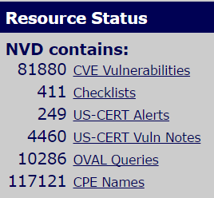
CVE and NVD
Assets
Vulnerabilities
Threats
Controls
CVE
Common vulnerabilities and exposures
Provide common names and identifiers for all publicly known software vulnerabilities
Facilitates discussion
Maintained by Mitre
Non-profit R&D organization
NVD
National vulnerabilities database
Likely impacts of each CVE vulnerability
Recommended measures to remove each CVE vulnerability
Industry-government collaboration
https://cve.mitre.org/
https://nvd.nist.gov/
Notes:
Link between CVE and NVD:
Most vulnerabilities typically reported by vendor itself, i.e. vulnerability has been verified to exist
Added to CVE database after public report
Detailed information about the vulnerability usually found at the vendor’s site
CVE not “whistle-blower” or “watchdog”
CVE and NVD are primarily central repositories of known vulnerabilities

Slide 9
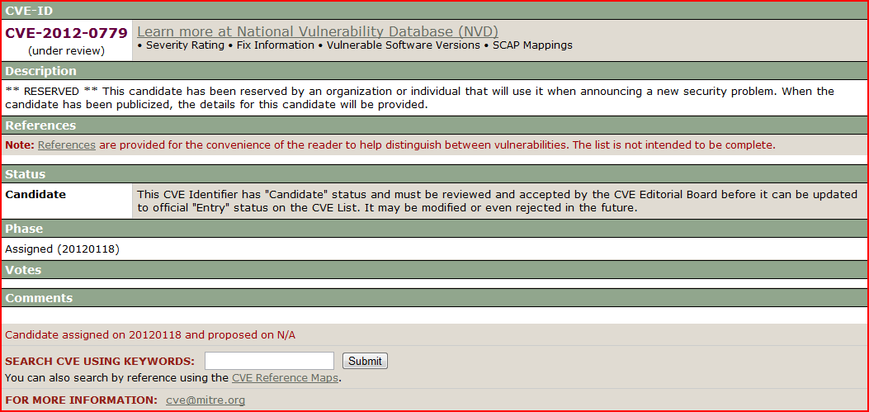
CVE example
Assets
Vulnerabilities
Threats
Controls

Slide 10
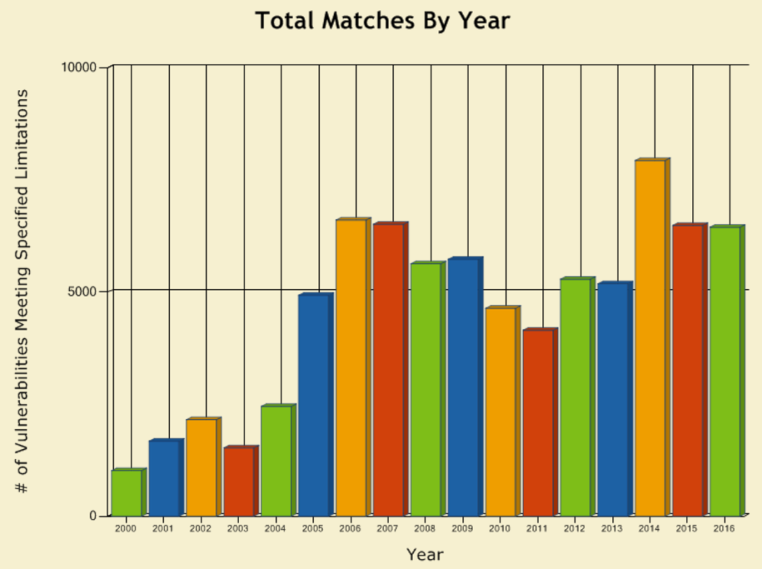
Vulnerability statistics
Assets
Vulnerabilities
Threats
Controls
Average of 11 reported vulnerabilities/ day (May 2012)
Mostly reported by vendors themselves
New vulnerabilities*
2010: 6,253
2011: 4,989
Drop: ~20%
Attacks*:
2010: 5.5 billion
2011: 3 billion
Industry publishes top 25 vulnerability causing errors for the year from this database

Slide 11
Threats
Assets
Vulnerabilities
Threats
Controls
Definition
Capabilities, intentions and attack methods of adversaries to exploit or cause harm to information
Examples
Someone trying to steal intellectual property
Someone trying to guess passwords
Atlas threat monitor
Uses sensors deployed at major ISPs worldwide
Threat Evolution
80’s
Pranks
No malicious intention
2000
Disruptive
Malicious
Denial of service outcomes
Not yet profit seeking
2010+
Primarily profit seeking

Slide 12
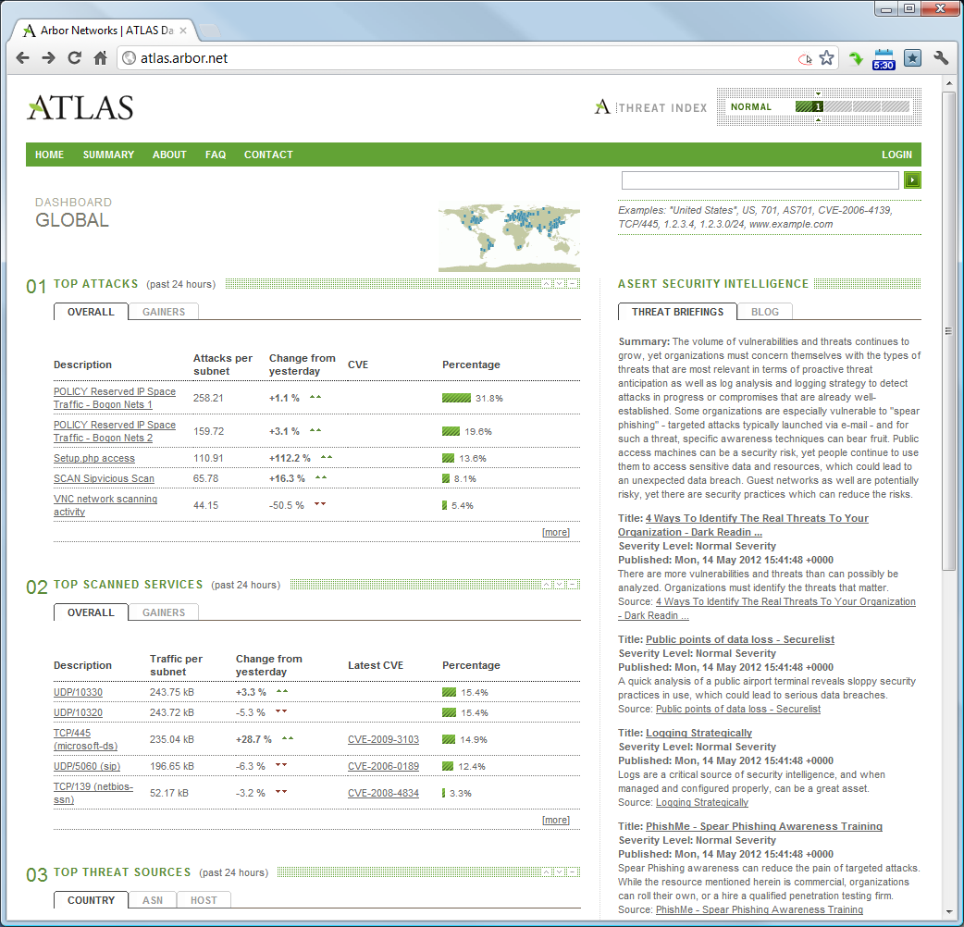
Atlas threat monitor
Assets
Vulnerabilities
Threats
Controls
ATLAS = Active Threat Level Analysis System
https://www.arbornetworks.com/atlas-portal
Redesign in progress

Slide 13
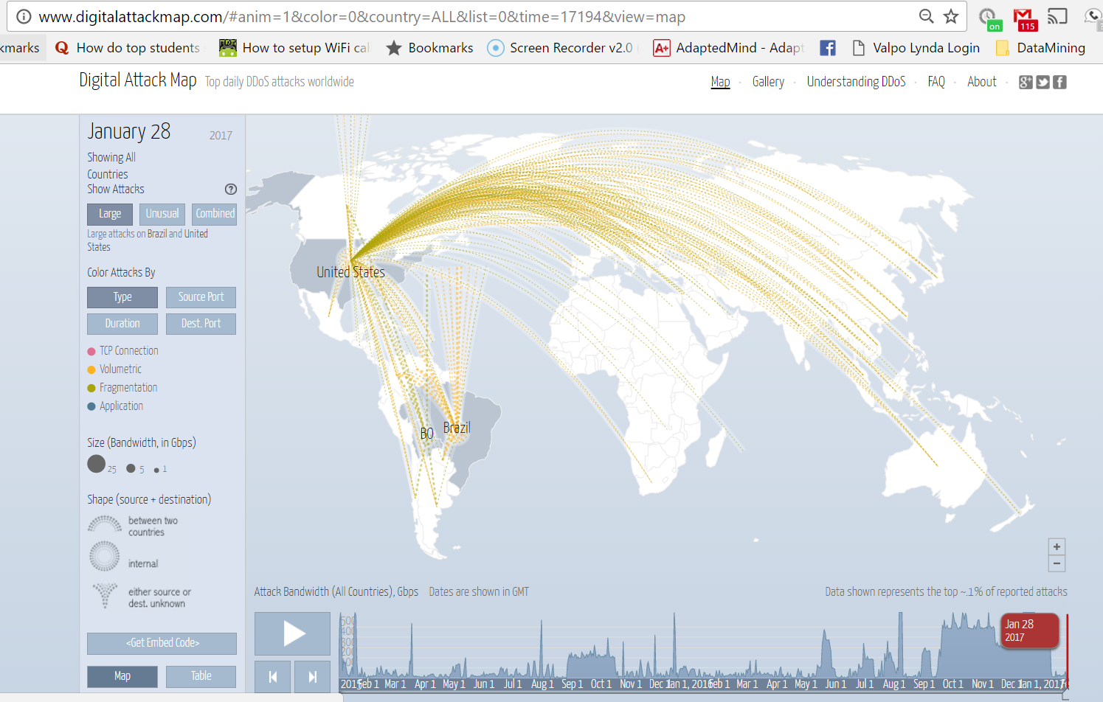
Digital Attack Map
Assets
Vulnerabilities
Threats
Controls
http://www.digitalattackmap.com/
Notes:
Threat Industrialization
Information security attacks targeted towards profit-seeking E.g. Ramnicu Valcea, Romania* (aka “Hackerville”)--http://www.news.com.au/technology/online/hacking/inside-hackerville-the-worlds-biggest-cyber-crime-hub/news-story/d7d336113ac1c404d6cc467d5221f93c
Led to the development of tools
Integrated development environments and toolkits (Zeus, Spyeye)
Remove entry barriers
No more creating exploits from scratch
Wider population can become attackers

Slide 14
Controls
Assets
Vulnerabilities
Threats
Controls
Definition: Safeguards used to minimize the impact of threats
System administrator response to vulnerabilities and threats
Controls
Examples
Strong passwords
Backups
Simple controls can be very effective
Passwords
Personal firewalls
Backups
Only a small fraction of threats actually cause damage
But one successful threat can be lethal
May not be detected until late
Information security goal
Deploy appropriate controls
Not all possible controls
Maximize returns from security investment

Slide 15
Common vulnerabilities
Software vulnerabilities
Error in specification, development or configuration of software such that its execution can violate the security policy
Procedural vulnerabilities
Weakness in an organization’s operational methods, which can be exploited to violate the security policy

Slide 16
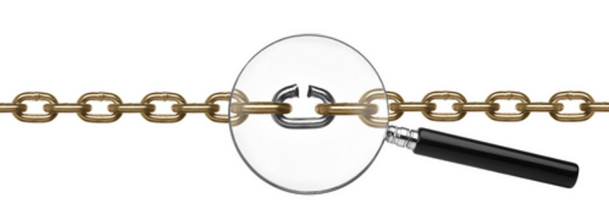
Software vulnerabilities
Lack of input validation in web-based DBs ➔ SQL Injection
Unverified file uploads
Buffer Overflow
Missing authorization
Cross-site scripting
Unencrypted Data
Notes:
Lack of input validation
Definition: User input not verified for appropriateness
Lethal in web software
User input used as parts of SQL queries into databases
Knowledgeable user can exploit input
Example: SQL injection (e.g. Use of unvalidated SQL input in web-based applications)
query = "SELECT * FROM items WHERE itemname = '" + ItemName.Text + "'";
// expected user input for ItemName: pencil;
// actual user input for ItemName: pencil OR 'a'='a';
// query result is:
SELECT * FROM items WHERE itemname = pencils OR 'a'='a';
// which translates to:
SELECT * FROM items;
2. Unverified uploads
Definition: Files are accepted by software without verifying that the file follows strict specifications
Example: File uploads on web sites
Expected file type: images, videos
Actual file type: input logger, robot etc.
All uploaded files should be checked for malice
3. Cross-site scripting
Definition: User-supplied input is used without verification as part of the output served to other users
Abbreviated as XSS
Common scenario
Forum posts may have html links with embedded JavaScript
If a user clicks the link, the JavaScript is activated in the background
JavaScript can take information from forum and apply it to link target
Hence the name cross-site
Information from one site (forum) used to compromise another website
4. Buffer overflow
Definition: Program puts more data into a storage location than it can hold
Usually benign: Only causes software crash
However
Knowledgeable user can craft special input to make program crash in predictable ways
Goal is generally to get a remote connection
As administrative user if possible
Avoidance requires careful programming
5. Missing authorization
Definition: Program allows users access to privileged parts of the program without verifying the credentials of the user
Possible due to project management oversight in large web sites
Example: May 2011, Citigroup
Hundreds of thousands of bank accounts compromised
6. Unencrypted data
Definition: Sensitive data is stored locally or transmitted over a network without proper encryption
Examples: Email user names and passwords; Unencrypted hard drive in stolen laptops

Slide 17
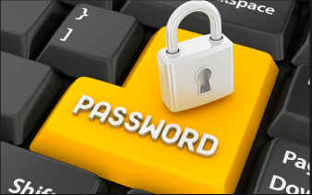
Procedural vulnerabilities: Passwords
Length
8 or more characters
Complexity
Numbers, letters and punctuations
Variation
Change periodically so that any theft is eventually ineffective
Variety
Different passwords for different sites (esp. financial and non-financial)

Slide 18
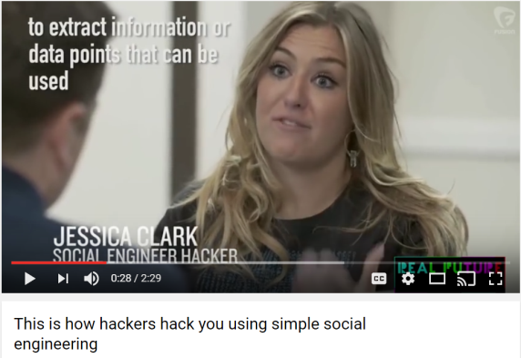
Procedural vulnerabilities (contd.)
Training procedures
Employees must know what actions have information security implications
Employees must know what to do in these situations
Minimal procedures and training
Employees must never be asked for user credentials on the phone or online
Employees must know they should never act on such requests
Attends to most common social engineering and phishing threats
See https://www.youtube.com/watch?v=lc7scxvKQOo

Slide 19
Threats
The best known threats
Viruses/ worms
DDoS
Malware
Rootkits
Zero-Day Exploit
Zombies/ Botnets
Packet Sniffing
Password Guessing
Social Engineering
Advanced Persistent Threat
Limited only by the
imagination of the attacker
Notes:
Viruses/ worms
Programs that adversely affect computers and propagate through the network without the user's consent
Modern viruses cause all possible damage within few minutes
E.g. Slammer worm, Jan 25, 2003
Reached 90% of all vulnerable targets within 10 minutes of release
ILOVEYOU virus
International legal differences became apparent
2. Denial of service
Unauthorized prevention of access to resources or the delaying of time-critical operations
Usually by making numerous unnecessary requests
Commonly known by abbreviation DOS
Distributed DOS: Use of many compromised systems to cause denial of service for users of the targeted system
Often, relatively straightforward to respond
3. Malware
Any software or code specifically designed to exploit a computer, or the data it contains, without consent
Usually
Key loggers
Track (log) keys struck on a keyboard, typically trying to gather usernames and passwords
Zombie clients
Software that takes directions from a remote computer and uses the infected computer to perform malicious tasks as directed
Users often unaware of existence
Modern anti-virus softwares usually include malware detectors
4. Rootkits
Collections of software programs used to hide the existence of malicious software on computer systems.
Typically give unauthorized users root access--and hide the actions of the unauthorized user
Typically replace system utilities, e.g. ls, top
Very difficult to remove
5. Zero-day exploit
Compromise a previously unknown vulnerability
Developers had zero days to address the vulnerability
But someone else had discovered the vulnerability
And found a way to exploit it profitably
RSA example
Targeted date
Mar 17, 2011
Exploit release date (suspected)
Feb 28, 2011
6. Zombies
Computer connected to the Internet, performing malicious tasks at the direction of a remote controller
Also called bots
Owners of the zombified computers often unaware of compromise
Pricing
100,000 – 2,000,000 zombies
24 hour rental
$200
Uses: Spam, DOS, dictionary attacks
Mega-D botnet: One of the most famous botnets
Oleg Nikolaenko
Arrested in Las Vegas Nov 4, 2010
Owned about 500,000 zombies
Originator of approx. 30% of all spam in 2008
7. Packet sniffing
Intercepting and monitoring data passing through a computer network
Very easy to do with Wireshark
All unencrypted data is vulnerable
T J Maxx: Poster child of threat
8. Password guessing
Repeatedly trying different passwords associated with a user account until the correct password is found
Any sequence of failed login attempts should be flagged
Twitter, 2009
18-year old student
Ran password guessing program all-night
Success:
System administrator at Twitter
Username “Crystal”
Password “happiness”
9. Social engineering
Art of manipulating people into performing desired actions
Exploit human desire to be helpful
Commonly used to initiate other attacks
Common method
Send customized email to lower level employees
Include attachments with zero-day exploits
Exploit installs key logger, bot etc.
Result often is APT (Advanced Persistent Threat)
https://www.youtube.com/watch?v=lc7scxvKQOo
10. Advanced persistent threat (APT)
Sustained, human intensive attack that leverages the full range of computer intrusion techniques
Human-effort intensive
Surgical
Customized for target organization
Generally cannot be reused
Threat often refers to group behind attack
Not attack itself

Slide 20
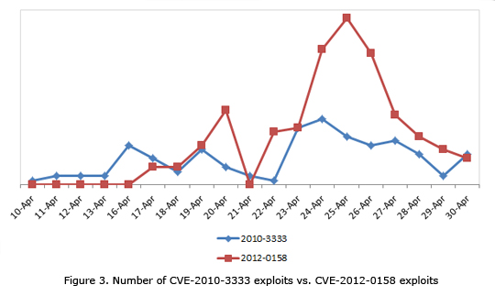
Vulnerabilities and threats
Successful threats are long-lived
Vulnerabilities slow to be patched
New vulnerabilities are quickly exploited

Slide 21
Controls
Popular classification
Physical controls
Traditional non-technical methods of preventing harm
E.g. background checks, locks
Procedural controls
Prescribed plans of action that govern the use of computer resources
E.g. double entry book-keeping
Two principles
Personal accountability
Forced co-operation
“When thieves fall out, honest men get their dues”
Technical controls
Security measures built into the information system itself
E.g. Automatic updates, firewalls, passwords

Slide 22
Controls
Large organizations
Procedures are very important
Replicate proven methods across all employees
Fuzzy categories
Most controls fall under multiple categories
E.g. Passwords
Technical?
Procedural?
Physical?

Slide 23
Summary
Basic information security model
Traditional security vs. information security
Common vulnerabilities
Important threats
Popular controls

Slide 24
Chapter Review Questions
Briefly describe the information security model shown in Figure 4.1.
What is an information asset? Give some examples from your personal life (it is enough to list some categories of assets, please do not violate your own privacy while responding to questions).
What are some important differences between conventional assets (e.g., gold, real estate) and information assets? How do these differences impact information security?
What are vulnerabilities? List some vulnerabilities to the assets identified in question 2.
What is the National Vulnerability Database (NVD)? Why is it useful?
What is the latest vulnerability recorded by the NVD? (to answer this question, visit the NVD at http://nvd. nist.gov/, click on the link to the “vulnerability search engine” and click “search,” leaving default values in all fields.)
What are threats? List some threats to the assets identified to the assets identified in question 2

Slide 25
Chapter Review Questions
Visit the ATLAS threat index site. What is the top attack on the day of your visit?
What are controls? What are some important controls you can implement to minimize the impact of the threats in the previous question.
Briefly describe the “lack of input validation” vulnerability. Why is it dangerous?
Briefly describe the “unrestricted upload” vulnerability. What harms can this vulnerability cause?
Briefly describe the “buffer overflow” vulnerability.
Briefly describe the “missing authorization” vulnerability. .In what industries is this vulnerability particularly harmful?
What are procedural vulnerabilities?
What are the recommendations for creating good passwords?1
What are viruses and worms? What is the primary difference between them?
Provide a brief summary of the ILOVEYOU virus and its impacts.

Slide 26
Chapter Review Questions
What is phishing?
What is malware?
What are rootkits? Why are they dangerous?
What are zombies? What are they commonly used for?
What is social engineering? Why is it an increasingly important threat?
What are physical controls? Why are they important?
What are procedural controls? Why are they important?
What are technical controls? Give some examples of technical controls.

Slide 27
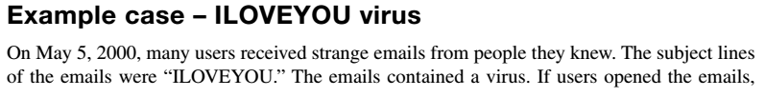
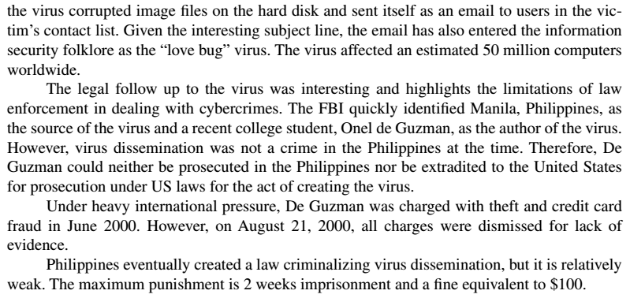
Example case: ILOVEYOU

Slide 28
Example Case Questions
What was de Guzman’s motivation for releasing the ILOVEYOU virus?
What is the penalty for creating and/or disseminating a virus in your country?
Laws typically allow judges considerable latitude in awarding sentences based on the facts of the case. Based on your response to question 2 above, what penalty would you award de Guzman?
Why did you choose this penalty?

Slide 29
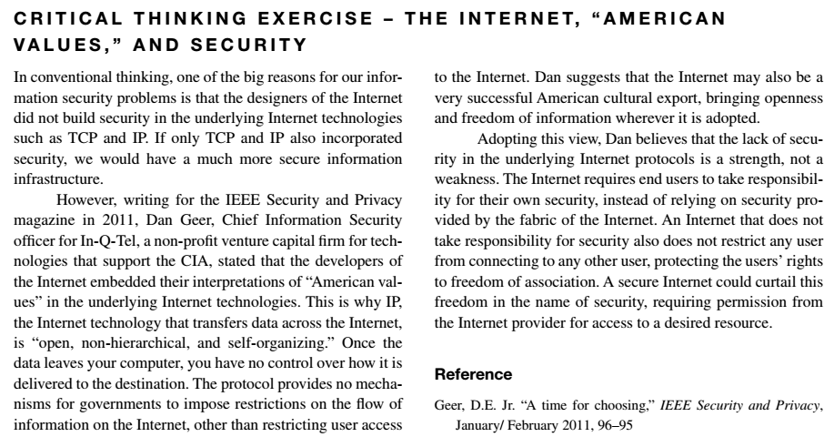
Critical Thinking Exercise

Slide 30
Critical Thinking Exercise Questions
How could our information infrastructure been more secure if the underlying Internet incorporated security technologies such as encryption?
How could the usability of the Internet been crippled if the underlying Internet technologies had incorporated more security?
Based on your responses to these two questions, do you agree with Dan Geer’s assessment that leaving security to be the responsibility of end users is a good idea?

Slide 31
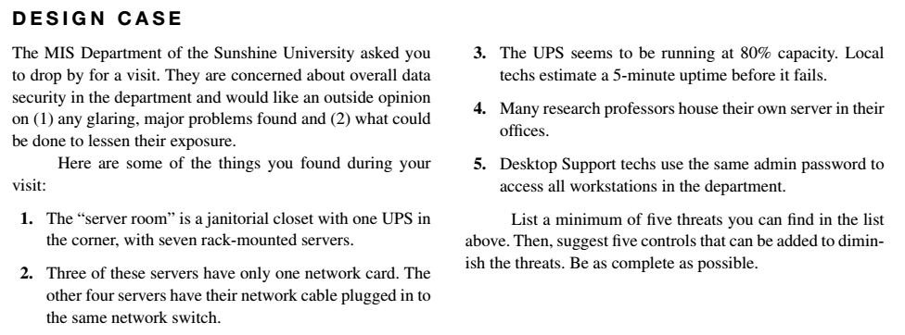
Design Case

Slide 32
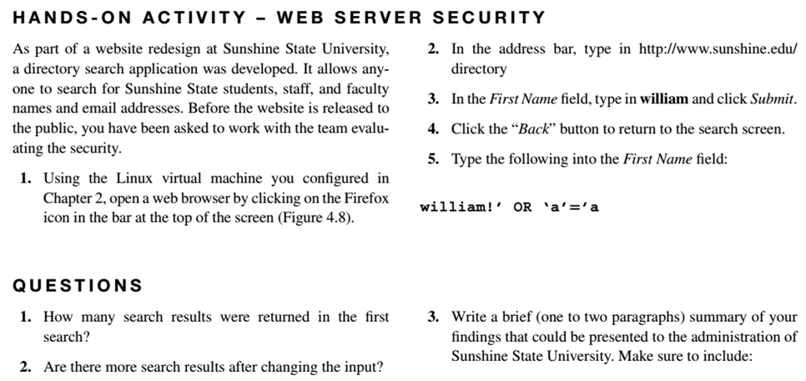
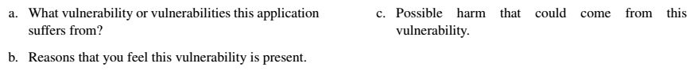
Hands-on Activity

Slide 33
Discussion 4
POST (due WED 11:59 pm CST): ﻿﻿﻿﻿﻿﻿﻿Download and install Wireshark from https://www.wireshark.org/.﻿﻿﻿﻿﻿﻿﻿﻿﻿﻿﻿﻿ Then use Wireshark to observe traffic on your home network or our campus, while you read your email or post to a social media account. Capture about 5 minutes of output and review it. What do you see? How hard is it to interpret your output? If you think about the TJ Maxx case, in which criminals stole unencrypted passwords through packet sniffing, would it still be possible today to copycat this crime?
RESPONSES (due FRI11:59 pm CST): Respond to two of your peers' posts. What security measures and controls will prevent packet sniffing from being successful? (You may have to do some research for your responses).

Slide 34
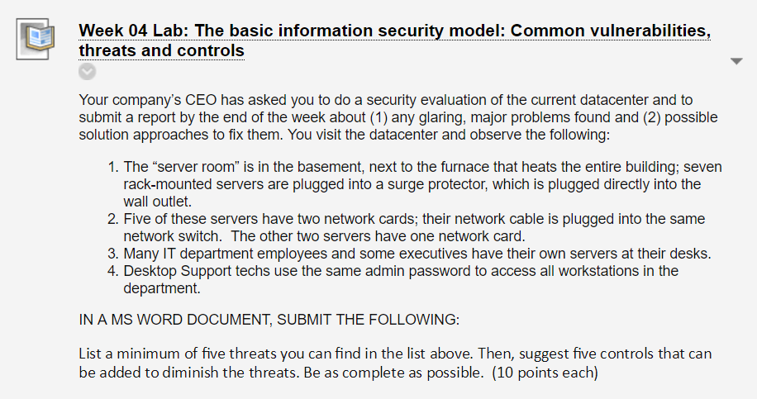
Homework Lab_4

Slide 35
For Next Week
# | Topic | Reading | Due Sunday 11:59 pm CST on Blackboard
5 | Asset Identification and Characterization: IT asset lifecycle and asset identification, system profiling, Asset ownership and operational responsibilities | Agrawal 5 Other materials on Blackboard | W: Post F: Responses S: LAB_5

